Slide 1
Enabling Digital Opportunities for the Construction Industry
September 2022
Notes:
FRAME, say something like:
Hello Mr Construction Company Owner/Operator,
We’ve been looking after construction customers of all types for many years. More recently, we’ve been investing time and money researching what’s really going in the industry – what challenges you’re facing, and what opportunities you have for growth.
Underpinning all of that, of course, is technology – so, we’ve been considering how IT can help customers like you.
Would it be OK if we walk you through our research so we can understand which challenges and threats resonate in YOUR business?

Slide 2
The construction industry is currently in the middle of a transformation. To keep up with demand, climate change and modern working requirements, it must shift away from its traditional operating processes towards a new, digital construction ecosystem that leverages digital data to inform, define and control the built environment.
There is a global need to spend at least $57 trillion on infrastructure by 2030 just to keep up with global GDP growth
The world’s largest consumer of raw materials, and constructed entities account for between 25 and 40% of total world carbon emissions
Productivity has averaged around 1% annually over the past two decades, compared with 3 to 4% across other sectors
57tn
40%
1%
Notes:
Background notes to inform your customer conversation:
Global megatrends are driving infrastructure development and renewal, with a global need to spend $57 trillion by 2030 just to keep up with global GDP growth before spend on climate change.
To meet the Paris Climate Change Agreement and the UK’s commitment to be net-zero by 2050 there needs to be a huge shift in the climate footprint for existing and new infrastructure.
However, productivity has averaged around 1% annually over the past two decades, compared with 3 to 4% across other sectors. Therefore, the industry must rapidly digitise and improve the way it shares data to improve project execution, cost performance and the sustainable optimisation of assets.
Closing this productivity gap would increase output by an estimated $1.6 trillion per year.

Slide 3
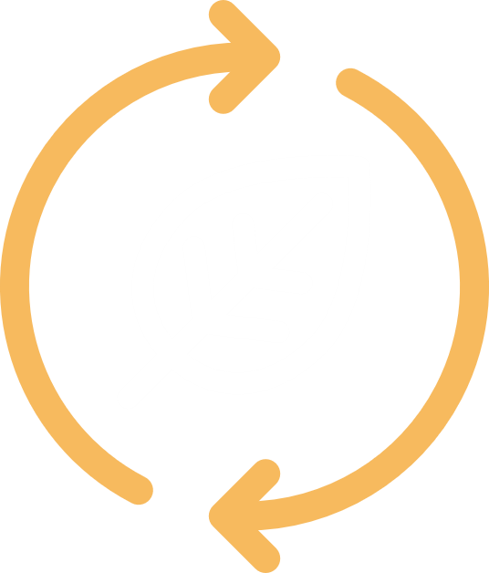
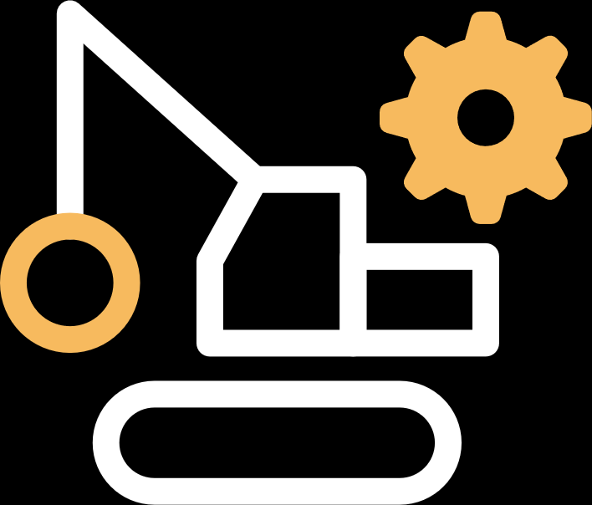
The journey to ‘construction firm of the future’
At Softcat, we believe the pressures influencing your organisation’s journey to becoming the construction firm of the future are actually your digital opportunities.
Current state
Needs
Future state
Demand
Meeting the increased need for construction to address today’s infrastructure requirements.
Skills
Facing the challenge of skills shortages and the need to keep the workforce safe.
Sustainability
Operating more responsibly by reducing waste and emissions to meet government targets.
Productivity
Delivering projects on time and to budget
Profitability
Calculating bids more accurately to avoid delays, rework and cost overruns –and maximise margins.
Retail customers have high expectations of corporate behaviour.
Notes:
Conversation guidance
These are points for discussion
Do these subjects or drivers resonate with your customer?
To what extent?
Background notes to inform your customer conversation:
Given the challenges we see, we believe that firms in the industry are under pressure and therefore many of them are on their own journeys towards a digital construction ecosystem.
Five main pressures are fueling this transformation:
Demand: Today, there is an increased need for construction in order to build the infrastructure required to meet the demands of a growing population.
In the UK alone, the population will rise to 75 million by 2050 and the government has put in place a £483bn plan to improve transportation, energy, water, housing and broadband. In the short-term projects may be delayed by the pandemic, especially in commercial sectors, but ultimately demand will be accelerated by post-COVID-19 stimulus packages.
Skills: Construction employs 100m people globally & 2.4m in the UK but has an acute worker shortage. The lack of skills (40%) and talent shortages (39%) impacts productivity. This may be alleviated in the short term by the economic crisis. However, almost a third of the UK workforce are approaching retirement age. It is also the least safe industry, although only accounting for 5% of the UK workforce, it has 36% of fatal injuries and 10% of major injuries.
Sustainability: Buildings and construction accounted for 36% of final energy use and 39% of carbon dioxide (CO2) emissions in 2018, 11% of which resulted from manufacturing building materials such as steel, cement and glass. Construction, demolition and excavation generate around three fifths (61%) of total UK waste. Consequently, the government has targeted a 50% greenhouse gas reduction by 2025, so construction firms will be under increased pressure to do their bit. By 2050, new infrastructure and renovations will have net zero embodied carbon, and all buildings must be net zero operational carbon. The UK Ten Point Green Revolution Plan will drive adoption.
Productivity: The traditional project-focused approach to construction, along with the fragmentation of skills, people-intensive processes and low digitisation means that construction is one of the least productive sectors – so it must improve to meet new demand.
Up to 35% of time is non-productive and only 50% of activities are on schedule. Large projects typically take 20% longer to finish than scheduled and are up to 80% over budget. Up to 20% extra productivity has been lost to COVID precautions. The UK Construction Playbook has set standards on digital adoption which will help improve productivity on government projects.
Profitability: With typical margins of 5 to 7%, underestimating a bid by 10% without the ability to recover the extra costs can make a project an expensive money-loser.
Misjudging risks can also be costly, so more must be done to calculate them better. In addition, delays and a lack of productivity are expensive issues. And if whole of life costs are not designed into the bid they can end up impacting profits too.

Slide 4
Tracking the key drivers
Demand
Skills
Sustainability
Productivity
Profitability
Inflationary pressures are beginning to bite.
Construction output has declined for the first time since January 2021, according to the latest monthly PMI report. House building declined for the second month running. Some construction companies cited a lack of new projects to replace completed contracts.
Skills remains a key pinch point.
The construction industry needs to add more than a quarter of a million workers by 2026 to keep pace with demand, according to the Construction Industry Training Board.
The body’s latest Construction Skills Network reported that 53,200 additional workers would be needed each year, with carpentry and joinery identified as particularly susceptible to recruitment pinch points.
The top sector challenge in the next two decades is the transition to net zero.
Achieving carbon neutrality demands smart buildings.
Tarmac orders UKs first battery electric mixer truck.
Proposed legislation for Heat Network Zoning from the Department for Business, Energy and Industrial Strategy (BEIS) changes the way that energy systems are developedand represents a huge opportunity for the industry worth £60bn-£80bn over 15 years.
Productivity has averaged around 1% annually over the past two decades.
More than half of construction firms are plagued by inefficient workflows. While 61 per cent of the companies surveyed used multiple software platforms to manage their day-to-day operations, fewer than 40 per cent of them automate workflows in critical areas of business. 70 per cent of construction firms identify a lack of visibility into materials availability and delivery status as their primary challenge each day.
Inflation is having a significant impact. Construction companies will need to take action to protect profitability.
Construction costs have been predicted to increase by 14.1% by the end of the year. The increase has been forecast due to a number of issues, including a lack of workers, general inflation, supply chain problems and ongoing issues around the Covid-19 pandemic and the war in Ukraine.
Rising labour costs eat away at construction firms profits.
Notes:
These are the drivers we have tracked in the last quarter. How do they impact you?

Slide 5
Transforming to the digital construction ecosystem
Traditional Construction
Digital Construction Ecosystem
Project-by-project focus
Demand
Post-COVID stimulus
Digital Delivery
People intensive & manual processes
Skills
Maintaining the workforce
Contextual Design
Fragmented ecosystem
Sustainability
Zero carbon infrastructure
Intelligent Workforce
Non-sustainable materials
Productivity
Delivering to time & budget
Sustainable Construction
Limited IT and R&D investments
Profitability
Increasing returns
Smart Built Environments
Notes:
Conversation guidance
These are points for discussion
Do these subjects or areas of transformation resonate with your customer?
To what extent?
Background reading on slide content for context.
This shows the general journey that the industry is on. Moving from a a project-by-project focused, people intensive fragmented ecosystems using non-sustainable materials and with limited IT & R&D investment. Towards a digital construction ecosystem that leverages the real-world to inform design, manages the delivery process through digital tools and shared data, leveraging a connected and automated workforce to build using sustainable materials and methods to create a smart built environment that maximises operations and minimises the climate impact.
These changes will not happen overnight but is an individual journey for every company.
Digital Delivery. Digitised processes, better collaboration, data exchange and a single view of the truth could drive a 20% reduction in costs. The need for digital tools, project management & collaboration, building information modelling (BIM) and a common data environment to drive productivity across a construction project is increasing
Contextual Design. The right design has a significant impact on the lifetime costs, environmental impact and contractors profitability. There is an increasing need to blend adoption of Building Information Modelling (BIM) with geospatial (GIS) technologies that bring in the real world context to improve the upfront design sustainability. GIS, Augmented Reality and design technology will be linked to BIM.
Intelligent Workforce. Only about 50% of planned activities on a construction site are completed on schedule. Workers at construction sites still spend about 30% of their time simply waiting to do their jobs. There is firstly a need to connect workers to the right applications and data that can drive productivity and safety. In future thee is a need to introduce more automation and robotics to drive more productivity. Up to 49% of tasks could be automated, especially repetitive ones through robotics. All will need reliable and secure connectivity.
Sustainable Construction. Embodied carbon (from the materials and construction process) in buildings and construction accounts for 11% of GHG emissions. The construction industry is the largest consumer of raw materials. About 40% of solid waste derives from construction and demolition. By 2050, new buildings, infrastructure and renovations will have net zero embodied carbon. Low cardon design, low or zero carbon materials and low or zero carbon construction techniques will need to be adopted, e.g. modular construction, electric vehicles and plant etc.
Smart Built Environments. Buildings construction and operations accounted for 36% of global final energy use and nearly 40% of energy‐related CO2 emissions in 2017. Global buildings sector energy use continues to grow, but not as quickly as population or floor area. All new buildings need to be net zero by 2030. Capacity is also an issue with much infrastructure such as transportation and energy. Technology such as IoT and Digital Twin analytics will be used to drive optimisation of operations such as reducing heating or lighting needs.
Digital investments will be needed to take advantage of these transformations. Some estimates believe that digitisation could reduce project costs by 45%.
Fundamentally banks will need to adopt three key technology approaches:
• Mobile-first for the new normal digital experiences
• Cloud-first for operational efficiency and time-to-market gains
• API-first for effective ecosystems collaboration.

Slide 6
Tracking the transformations
Digital Delivery
Contextual Design
Intelligent Workforce
Sustainable Construction
Smart Built Environments
Collecting real-world data is key to productivity.
Despite the higher uptake of digital technology in the region, 92% of European construction professionals still have "concerns about the future of digital transformation, highlighting the need for a more human-centric approach", European respondents identified uneven or sporadic implementation (52%), process and data integration issues (54%), and technical and system limitations (49%) as key problems.
Blending digital and real-world data is key to good design.
Augmented Reality presents real-time data using cameras and GPS geo-spatially. It displays and updates essential information as the user travels throughout the infrastructure space. Due to the ability of AR to provide real-time information, the construction industry will be able to improve safety, streamline operations and collaboration, increase productivity and boost project confidence.
Increasing productivity relies on a connected & automated workforce.
A high percentage (90%) still use outdated methods (email/Excel/paper forms) for 25-100% of their business processes.
Robotic dog spotted taking digital construction to the next level. “Using technology like Spot provides building scanning, soil analysis, ground water contamination and ground stabilisation to effectively and safely bring those sites back into use.”
The green buildings market is predicted to grow at 14.3% CAGR by 2027.
Standardising ESG in construction (Environmental, Social and Governance) requires hard data, not soft objectives. Empowering ESG in construction requires Trust. This is a core principle of Blockchain along with its immutability and accountability characteristics. It accurately records activity along a supply chain, which can then be assessed for compliance and shared to validate construction ESG claims.
Digital is crucial to sustainable buildings.
Construction companies are increasingly adopting IoT technology. IoT in construction offers benefits such as better productivity, maintenance, security, and safety.
The application of the metaverse to infrastructure is a logical progression for digital twins. These are founded on BIM data to create a representation of complex infrastructure. And with IoT, it is continuously updated from the physical world.
Notes:
These are the latest update in the transformation of the industry we have tracked in the last quarter. How do they impact you?

Slide 7
Mapping the digital opportunities
Demand
Skills
Sustainability
Productivity
Profitability
Connected data through the cloud
Enabling the remote & on-site worker
Securing your assets
Protecting margins through IT cost control
Hybrid infrastructure
Digital workspace
Cyber security
IT intelligence
Notes:
Background notes to inform your customer conversation:
So, we think our customers need to address demand, skills, sustainability, innovation and profitability in order to grow and thrive.
That’s where the conversation starts as we’ve identified four construction priorities which we believe will help create the IT foundations that will support the journey to a digital construction ecosystems of the future, these are
Connected operations through the cloud – Construction projects generate huge amounts of data, documents and workflows. Yet much data is lost and ineffective data sharing causes pricing misjudgements, project delays, reworks and cost overruns. Greater data sharing could release an additional £7bn per year of benefits across the UK infrastructure sectors equivalent to 25% of total spend. The industry trying to improve productivity by adopting digital and adopt new approaches. The cloud is the best solution to deliver the flexibility and scale needed to meet the data sharing challenge. Softcat’s approach is to be technology agnostic and work to bring the people, the experience and the right vendor partners to create a hybrid infrastructure transformation to deliver a Connected Data Environment (CDE).
Enabling the On-site Worker - Productivity is a significant issues for the construction industry, lagging behind other sectors. Improving productivity requires enabling the on-site teams to reduce non-productive time by being able to access the latest information, manage scheduling, manage material and equipment needs and meet safety and compliance demands. Mobile devices are key and Softcat can work in partnership with you to understand your organisation and leverage our unparalleled portfolio of partners to make specific recommendations to optimise the mobility requirements for your on-site workers.
Securing Your Assets – Construction firms have a dual security issue. The security of their own operations, assets and personnel as well as the ongoing security of the built asset they leave behind. We understand the demands on IT departments to continually develop and deliver a security strategy that meets current and future needs in an ever-changing landscape. Softcat’s unparalleled portfolio of partners and technologies, combined with our knowledge of the ever-evolving security market, ensures that your organisation will benefit from innovative solutions.
Protecting margins through IT cost control - And, to remain competitive and agile, controlling and optimising your IT estate ensures you can flex and change with the assurance that it is done so optimally
At Softcat, we help our construction customers meet these opportunities with a number of IT Solutions. We’ll briefly introduce them now – and then go into detail on the ones that apply to your business…
Hybrid infrastructure: We can help you leverage data across the lifecycle to deliver better building operations. With a hybrid infrastructure, we utilise the right mix of private, public and on-premise infrastructure to optimise the way your data is connected – helping to improve the quality of your processes.
Digital workspace: Our innovative solutions deliver effective communications across your connected workforce, facilitating better collaboration and enabling on-site workers to improve their productivity – ultimately helping you achieve greater profitability.
Cyber security: Our leading-edge cyber security offering helps you design in security from a project’s inception – securing your assets from the start. It means your customers can confidently partner with you and retain trust in you throughout your relationship together.
IT Intelligence: Softcat focuses on IT Intelligence which simplifies and de-risks IT operations to cut costs and deliver efficiencies.
(elevate the Softcat capabilities, or based on the conversation, focus on those that are a priority or of specific interest to your customer).

Slide 8
Tracking the changes in digitisation
Hybrid infrastructure
Digital
workspace
Cyber
security
IT
intelligence
Digitalisation in the construction industry is in full swing data and open data interfaces are becoming increasingly important.
Procore Technologies a leading global provider of construction management software, today announced it is working with Amazon Web Services (AWS) to leverage AWS IoT TwinMaker to extend the value of construction data into facility operations. The tools AWS IoT TwinMaker provides accelerate the creation of digital twins for buildings, factories, industrial equipment, and production lines.
Hybrid working is becoming the new normal.
59% of construction project owners report frequent breakdowns in communication between themselves and other project team members. Less than half (45 percent) report that they are satisfied with their connectivity with those external companies. 60% of owners report that they have digital workflows for at least half of their project data between departments within their organization. However, only 28% report a similar level of digital data exchange with external companies.
Construction is the fifth most at-risk industry for a cyber attack and is still not doing enough to prevent being hit in the future. The sector was given a risk score of 39, higher than financial services, energy and government.
A new construction cyber security guide has been developed in a between experts from industry and the National Cyber Security Centre (NCSC), the Department for Business, Energy and Industrial Strategy (BEIS) and the Centre for the Protection of National Infrastructure (CPNI). The advice in the Information Security Best Practice guide, is tailored to help firms protect the data they create, store and share in major joint venture projects.
The importance of the underlying IT infrastructure cannot be understanded in the future of construction.
Profitability in construction is low, at around 5% EBIT margin and the economic headwinds created by the pandemic and geopolitical uncertainty will only make things worse. Against this background construction firms will need to invest in digital transformation putting further pressure on margins. Managing a diverse IT estate across a network of projects that may not have local IT support is challenging.
Notes:
These are the latest updates in technology we have tracked in the last quarter. How do they impact you?

Slide 9
In summary
In order to meet increased demand, today’s construction firms must simultaneously maintain quality, improve sustainability, better productivity and achieve greater profitability.
The COVID-19 pandemic has accelerated digital transformation by three to four years, and highlighted the need for operational resilience in the new normal.
With the right support, you can optimise data connections, secure assets, enable workers and improve collaboration to meet these needs.
What’s more, existing digital technologies, when applied comprehensively and efficiently, can reduce overall project costs by as much as 45%.
Notes:
In summary, we live in challenging but exciting times for construction firms. We’re here to help you take advantage of every opportunity. As such, we can help you meet the increased demand for construction, and give you a competitive advantage in the modern construction landscape.
COVID-19 has accelerated expectations, economic challenges and operational resilience.
Digital is an enabler to this – so the foundations of their IT need to be addressed so that they can act with agility and flexibility; security is included ‘by-design’ rather than as an afterthought, and so that they can maximise their investments.

